Slide 1
Introducing Windows 7
Lesson 1

Slide 2
Objectives
Define Windows 7 interface refinements
Describe new features of Windows 7
Describe the six editions of Windows 7
Use the Upgrade Advisor to determine hardware and software compatibility
Describe the modular architecture of Windows 7
Notes:
Outline the material you are going to cover in this lesson. Do not go into detail as each of these points will be expanded on in the lesson. You may also want to mention the Technology Skills that are being covered for the Certification exam also.

Slide 3
What’s New in Windows 7
Windows 7 Interface Refinements
Desktop
Manipulating Windows
Keystroke Shortcuts
Notes:
Introduce the interface refinements that will be discussed. Explain that if you have Vista experience these are some of the new improvements that you may see. If moving from XP, more of an adjustment will be needed to get used to the interface. You may find it useful to explain some of the features of the Vista interface that are not being covered here, so that XP users are not left behind.

Slide 4
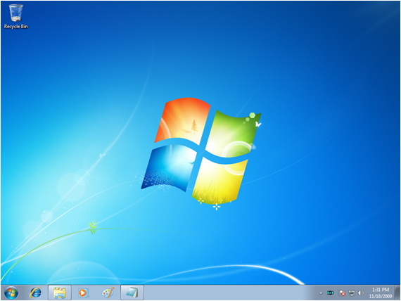
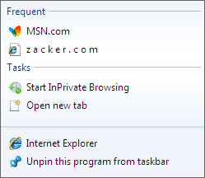
Windows 7 Interface Refinements
No Sidebar
New Jump Lists
Smaller
Notification Area
No Quick Launch
Pinned Items
Notes:
Describe some of the features that have disappeared from Vista or have changed. Also make sure to point out the additions.

Slide 5
Manipulating Windows
Aero Snap
Aero Shake
Aero Peek
Aero Task Switching
http://www.gcflearnfree.org/windows7/getting-started-with-windows-7/2/
Notes:
Describe each of these new methods for moving and resizing windows on the Windows 7 desktop.

Slide 6
Using Keystroke Shortcuts
Windows + Space – Causes the system to enter “peek at desktop” mode
Windows + Up Arrow – Maximizes the active window
Windows + Down Arrow – Restores the active window to its default size
Windows + 1 – Starts the first program on the taskbar
Notes:
While the keystroke shortcuts have been around for a long time, there are some new shortcuts with Windows 7 and some of the old ones do something different with Windows 7. Here are a few examples. Refer to the full list in the book.

Slide 7
Windows Feature Refinements
Explorer Libraries
Windows Search
Federated Search
Offline Files
VPN Reconnect
Group Policy
ReadyBoost
Notes:
Introduce the feature refinements. Windows Vista introduced many new features, but some of these have been refined or enhanced in Windows 7. Explain that although these may seem like simple changes, often times users have problems with these new features and it is important to be familiar with them if you are a desktop technician.

Slide 8
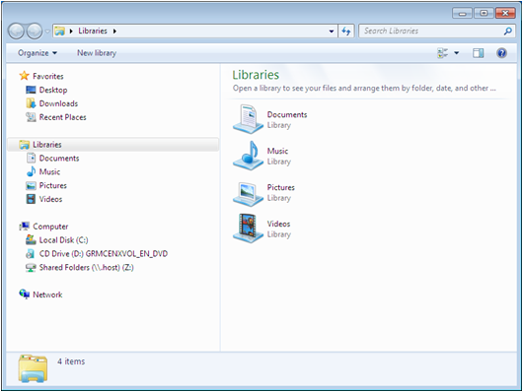
Explorer Libraries
Notes:
Note the Libraries in the Explorer Window. Explain that these libraries can actually contain and group files from multiple computers into a single folder that makes them appear as though they are on the local drive. The libraries shown are the 4 default libraries, but more can be added. Each one can contain multiple locations.
They appear in the Open and Save As options on the right side of the Start Menu, replacing the old Documents, Pictures and Music user profile folders. You may want to show this if you are using a Windows 7 computer.

Slide 9
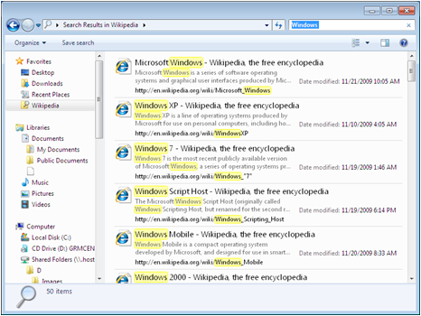
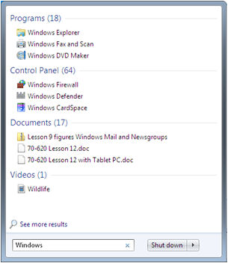
Windows Search (WSE)
Notes:
The Windows Search Engine (WSE) is a great improvement. Replaces the Search Assistant. You will now see a small search box on the Start menu, on Explorer Windows, in Windows Media Player and other places throughout the operating system. It enables users to perform context-sensitive, metadata-based, as-you-type searches from almost anywhere. You can also add Search Filters to refine your search.

Slide 10
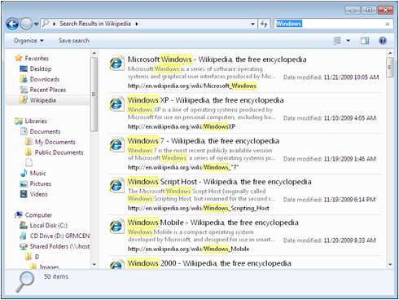
Federated Search
Searches SharePoint sites, intranets, and Internet sites.
Search connectors must be installed.
Notes:
When Search connectors are installed in Windows 7, a shortcut for the site appears under Favorites in the Windows Explorer window. You can then select the favorite and type a string in the Search box to perform a search on the site. Results get displayed in the Explorer window as shown above.

Slide 11
Offline Files
Enables users to store copies of network files on the local drive
Provides access when network is unavailable
Can exclude file types to prevent overloading the network
Notes:
Explain Offline Files and then expand by describing the synchronization process, and how it is invisible to users.

Slide 12
VPN Reconnect
Enables a remote computer to re-establish a connection to a VPN server running Windows Server 2008 R2, with no re-authentication
Reduces frustration with loss of connection when using unstable wireless networks
Notes:
Because wireless networks are used so extensively nowadays, and their connectivity can be so intermittent, improvements were needed in VPN technology to reduce the need for re-authentication every time the wireless connection was dropped. This re-authentication process can take several minutes each time, therefore reducing productivity and causing frustration.

Slide 13
Group Policy
New preference settings to control power management and task scheduling
Starter Group Policy Objects (GPOs) to simplify administration
http://gpsearch.azurewebsites.net/
Notes:
Group Policy has been around since Active Directory was introduced in Windows 2000. Explain what Group Policy is used for, and talk about the additions to Group Policy and why Starter Group Policy Objects are a great help to administrators.

Slide 14
ReadyBoost
Introduced in Windows Vista to use external storage devices (USB flash drives or SD cards) as a cache for data that might be swapped to the hard drive.
Windows 7 supports larger caches on as many as eight external devices simultaneously.
Notes:
Review ReadyBoost information from Windows Vista and explain how it is supposed to enhance the performance of your computer. Explain the improvements with Windows 7.

Slide 15
Introducing New Windows 7 Features
Action Center
BranchCache
DirectAccess
Windows PowerShell 2.0
Problem Steps Recorder
Resource Monitor
Wake on Wireless LAN
Notes:
There are many new features in Windows 7 that enhance the operating system’s ability to communicate with other computers on the network safely and efficiently. These are some of the most prominent new features. Do not discuss each feature here, as they will be discussed in the upcoming slides.

Slide 16
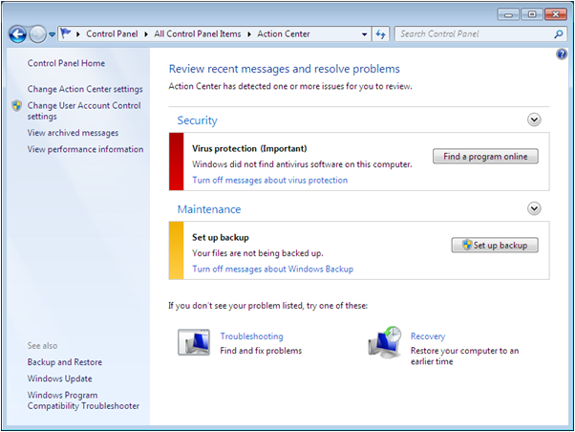
Action Center
Replacement for Vista’s Security Center
Notes:
Describe the old Security Center from Windows Vista and what it was used for. Explain why the name was changed and what new notifications are included in the new tool.

Slide 17
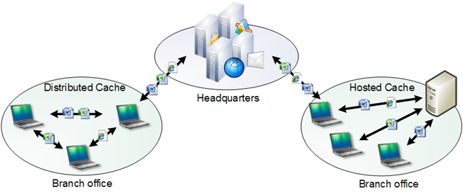
BranchCache
Windows 7 with Windows Server 2008 R2
Reduces WAN traffic
Allows branch office users to have faster and more reliable access to files they need
Notes:
Describe BranchCache briefly. It will be discussed in more detail in a later lesson.

Slide 18
DirectAccess
Simplifies VPN connection for end users
Automatically establishes a connection to the DirectAccess server when remote computer has Internet access
More complicated setup for administrator
Requires Server 2008 R2
Notes:
Describe how DirectAccess is a remote connection technology that is completely invisible to the end user, and that it simplifies the process of making VPN connections. Often times users need greater understanding of networking concepts than they possess in order to make their own VPN connections. While this is easier for users, it is more complicated for administrators to configure.

Slide 19
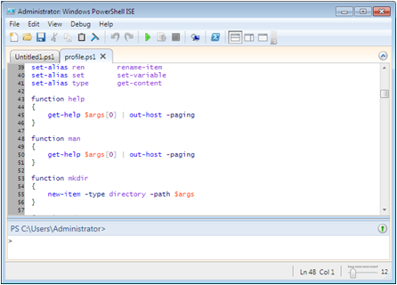
Windows PowerShell 2.0
Scripting and command line language
Can perform almost any task from the command prompt
Rich scripting language to automate tasks and create logon and startup scripts
Notes:
Explain how PowerShell is replacing VBScript and other languages supported by Windows Script Host. It is installed by default on Windows 7 and Server 2008 R2. There is a command prompt and a graphical interface.

Slide 20

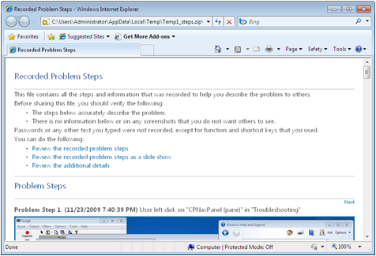
Problem Steps Recorder
Documents the process that generated an error
Start and Stop recording and add comments
Helps technical support personnel
Notes:
Explain what this tool does and why it is so helpful for technical support personnel.

Slide 21
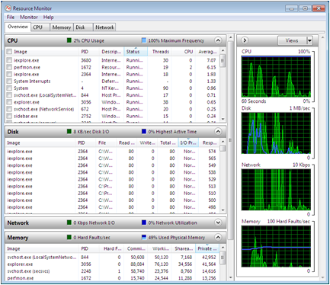
Resource Monitor
Displays information about:
CPU
Disk
Network
Memory
Enables you to suspend, resume, and end processes
Notes:
Explain how the Resource Monitor lists the processes that are consuming resources and enables you to suspend, resume and end processes as needed. Gives a great overview of what is happening on your computer.

Slide 22
Wake on Wireless LAN (WoWLAN)
Enables a computer in sleep mode to wake up on the receipt of a magic packet, on wired LANS
Is the equivalent standard for wireless networks
Notes:
Explain Wake on LAN and then explain Wake on Wireless LAN.

Slide 23
Introducing Windows 7 Editions
Windows 7 Starter
Windows 7 Home Basic
Windows 7 Home Premium
Windows 7 Professional
Windows 7 Enterprise
Windows 7 Ultimate
Notes:
Review the features of each of the editions of Windows 7. Highlight that as you move down the list that each higher edition is a true superset of the lower edition, and why this is a welcome enhancement from how the Windows Vista editions were. You may want to refer to the comparison table in the textbook as you talk about the differences between the editions or you can be more general.

Slide 24
Minimum System Requirements
1 gigahertz (GHz) or faster 32-bit (x86) or 64-bit (x64) processor
1 gigabyte (GB) RAM (32-bit) or 2 GB RAM (64-bit)
16 GB available hard disk space (32-bit) or 20 GB (64-bit)
DirectX 9 graphics device with WDDM 1.0 or higher driver
Notes:
Review the minimum system requirements for both the 32 bit version and 64 bit version of the operating system. Explain that the requirements are the same for each edition. These minimum requirements do not take into consideration the applications you will be running, but only the operating system. You may also want to touch on the hardware limitations of each edition of Windows 7, using the chart in the book.

Slide 25
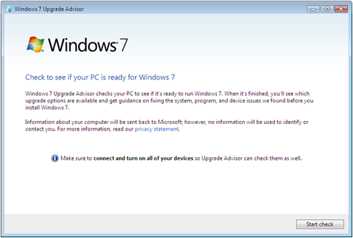
Windows 7 Upgrade Advisor
Easiest way to determine if your computer is capable of running Windows 7
Runs on Windows XP and Windows Vista
Notes:
Explain the Upgrade Advisor tool, how you run it and that it is a replacement for the old Hardware Compatibility List (HCL).

Slide 26
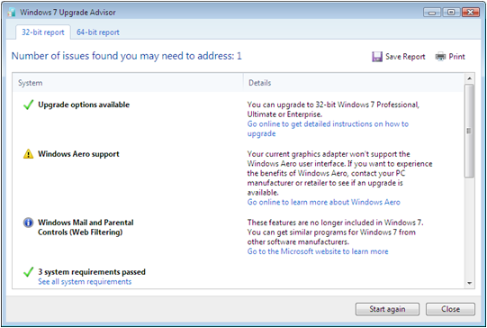
Windows 7 Upgrade Advisor Report
Displays a list of system requirements and/or devices that would prevent Windows 7 from running
Notes:
Explain what you will see in the report that gets generated by the Upgrade Advisor tool. Explain that it checks hardware and software and will make recommendations if upgrades are needed, or what you could do to improve your computer’s performance.

Slide 27
Indentifying Upgrade Paths
Windows Vista – Supports in-place upgrade
Install the new operating system over the old, leaving existing applications, configuration settings, and personal files intact
Previous operating system files stored in windows.old file
Notes:
Explain the difference between an in-place upgrade and a wipe and load, and then discuss, over the next 2 slides how to use each one when upgrading from either Vista or XP. Explain that there is an Upgrade version of the operating system that is available at a lower cost that the full version.

Slide 28
Identifying Upgrade Paths cont’d
Windows XP – Wipe-and-load upgrade only
Wipe away existing operating system
Install Windows 7
All software must be reinstalled
Data can be backed up and restored or migrated from old computer
Some configuration settings can be migrated
Notes:
See notes from previous slide.

Slide 29
Upgrading Windows 7 Editions
Windows 7 edition upgrade simplified
Each higher edition includes all of the features of the next lower edition.
Any retail product can be upgraded to any higher retail product.
Upgrade process is completely electronic.
No installation disk is required.
Use Windows Anytime Upgrade program
Notes:
Review why the upgrade procedure is simplified and why you no longer need the installation disk to perform an upgrade. You may want to show where the Windows Anytime Upgrade program is, if you are using a Windows 7 computer.

Slide 30
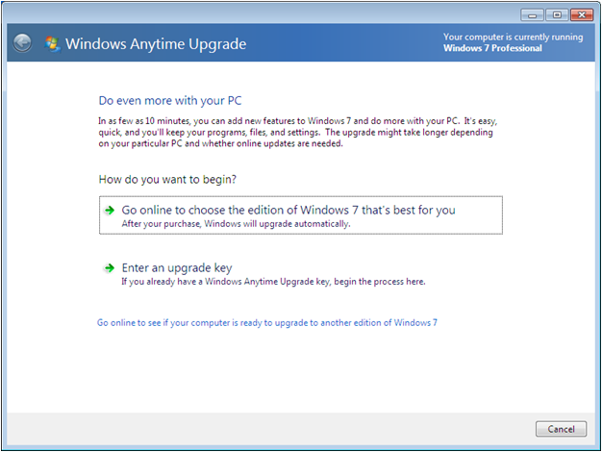
Windows Anytime Upgrade Program
Notes:
Explain that you must purchase the upgrade online, or have purchased the upgrade in a store. You can pay by credit card online or just enter the new upgrade key to unlock the additional modules that relate to the upgraded edition of Windows 7.

Slide 31
Upgrading from Windows Vista
Can only perform IN-PLACE upgrades as follows:
Vista HOME editions to Windows 7 HOME editions
Vista BUSINESS editions to Windows 7 BUSINESS editions
Any edition of Vista to Windows 7 Ultimate
Otherwise, do a migration
Notes:
Use this slide and the next to review the upgrade paths and to review in-place and wipe and load (migrations) upgrades. We are not discussing migration in detail at this point, but it is worth mentioning the tools that you might use to migrate settings and files. Note that migration does not necessarily bring all settings to the new computer. The migration upgrade is considered more stable than in-place upgrades.

Slide 32
Upgrading Best Practices
In-place upgrades do not preserve everything and take a lot of time
Not everything runs properly after the upgrade
Always use Upgrade Advisor to plan
Clean installations are most reliable
Migrate configuration settings and user data
Notes:
See notes on previous slide.

Slide 33
Upgrading from Earlier Windows Versions
No upgrade pricing available for Windows 2000, Windows ME, Windows 98, Windows 95, or Windows 3.1
Purchase a full version of Windows 7
Can only perform a migration, no in-place upgrade
Notes:
Review the versions of Windows that do have upgrade paths in place and which versions do not.

Slide 34
Windows 7 Modular Architecture
All editions of Windows 7 are distributed on a single DVD.
Product key determines which edition is installed.
Modular architecture:
MinWin module – Common core module
Edition-specific module
Language module
Notes:
Explain the modular architecture of Windows 7, explaining why all editions fit on a single DVD.

Slide 35
Skills Summary
Windows 7 includes a variety of interface refinements, as well as new and refined features.
Windows 7 is available in six editions. Each successive edition is a superset of the next lower one.
Upgrade Advisor is an application that determines whether the computer’s hardware and software is compatible with Windows 7.
Windows 7 is based on a common core module called MinWin, an edition-specific module, and a language module.
Notes:
Review the Skill Summary to wrap up your lesson.

